Slide 1


DEPARTMENT OF COMPUTER SCIENCE AND ENGINEERING
BATCH 4
REAL TIME FIRE LOCALIZATION
TEAM MEMBERS:
SAKTHI SREE V – 211419104229
SOFIYA S – 211419104260
SWATHI P - 211419104281
GUIDED BY:
Dr. A. HEMLATHADHEVI, M.E., Ph.D.,
CO-ORDINATED BY:
MRS. K. VALARMATHI, ME., PhD.,

Slide 2
INTRODUCTION
Fire, an hazardous incident, poses a significant risk as it can be destructive and dangerous, causing wildfires, building fires, and explosions.
A fire can burn out of control, engulfing the area in heat and toxic with heavy smoke. So, it's crucial to spot and put out fire at its very beginning.
The majority of fire monitoring and alarm systems now in use rely on sensors, which have drawbacks such as low sensitivity, sluggish response, limited coverage, and poor stability.
This explores a way to develop a fire localization system using yolo5 network.

Slide 3
As security technology has advanced, cctv cameras are now mounted for surveillance at the majority of buildings and traffic lights.
Early fire detection and identification are possible using the camera's live footage.
YOLOV5 network is used for the successful detection and warning of fire disasters. So, the moment the fire occurs, it is detected precisely and alarmed.
Thus, a quick and extremely accurate fire detection could be employed day and night, regardless of size and shape was made possible by using the yolo5 algorithm.

Slide 4
OBJECTIVE OF THE PROJECT
The main objective of fire detection is to identify and alert people about the presence of a fire as quickly and accurately as possible, so that they can take appropriate action to extinguish the fire and evacuate the building safely.
Early detection of a fire is critical, as it allows the fire department to respond quickly and minimize damage to property and the risk of injury or death to people.

Slide 5
LITERATURE SURVEY
YEAR | TITLE AND JOURNAL PAPER | DESCRIPTION | ADVANTAGES | DISADVANTAGES
2023 | “Forest fire and smoke detection using deep learning - based learning without forgetting”, in Fire Ecology. | A classification model that can differentiate between fire and smoke in images by combining deep learning and transfer learning with hyper parameter tuning, reducing time and ensuring early detection. | Learning without forgetting(LwF) is used to overcome the disadvantages of Transfer Learning. | High rate of false Detection. Latest CNN model must be used to rapidly identify fre occurrences with a low rate of false positives

Slide 6
YEAR | TITLE AND JOURNAL PAPER | DESCRIPTION | ADVANTAGES | DISADVANTAGES
2022 | “Fire-Net: A Deep Learning Framework for Active Forest Fire Detection”, in Hindawi (journal of sensors). | A deep CNN(Fire-Net) was proposed in this work to detect active forest fires in various regions. Specifically, the USA and Australia regions were used to train the network whereas testing was done for Africa, Brazil, Ukraine, Australia (the parts that was not involved in training) regions. The results depicted a high transferability of the proposed method. | High accuracy rate( 92.64%). | rapid monitoring of active fires is not possible.

Slide 7
YEAR | TITLE AND JOURNAL PAPER | DESCRIPTION | ADVANTAGES | DISADVANTAGES
2022 | “Characteristics Based Fire Detection System Under the Effect of Electric Fields With ImprovedYolo-v4 and ViBe”, in IEEE Access. | The proposed system uses a simplified weighted bi-directional feature pyramid network (Bi-FPN) in place of the path aggregation network (PANet) as a feature fusion network in Yolo-v4. Using multiple dynamic fire characteristics, it can eliminate falsely detected frames. | Achieves fire detection with more dynamic fire characteristics compared with the image-based fire detection under the effect of electric fields. | Fire detection takes longer time.

Slide 8
PROBLEM STATEMENT
The issue of fire detection is an important challenge for public safety since it can cause significant damage to property and human life. Although there are numerous fire detection systems in place, they often have limitations that need to be addressed.
Specifically, current systems may face challenges in detecting fires in low-light conditions or detecting multiple fires simultaneously. In addition, there may be issues with false alarms, which can waste valuable resources and cause unnecessary panic.

Slide 9
To address these challenges, the implementation of an advanced fire detection system that incorporates artificial intelligence (AI) and machine learning (ML) algorithms is necessary.
Specifically, the YOLOv5 architecture can be utilized to develop a fire detection system that accurately detects fires in real-time, improves detection in low-light conditions, and reduces false alarms.
This project aims to develop a robust fire detection system that can help to improve public safety and prevent the loss of life and property caused by fires.

Slide 10
PROPOSED SYSTEM
The proposed model combines both open cv and deep learning algorithm(yolo5) to efficiently detect fire.
Yolov5 is faster than its earlier versions and offers improved speed and accuracy for object detection, classification and localization. It is a light weight model and it is easy to deploy that makes it suitable for real time application.
Pre-trained weights and configuration files of yolo5 algorithm is loaded into the webcam for image processing and fire detection.

Slide 11
The input obtained from webcam is resized to fit the network size of yolo5 algorithm.
Then, it is fed into the yolo5 network where object detection and labelling occurs.
If the labelling matches with the class fire, the system alerts with an alarm sound.

Slide 12
SOFTWARE REQUIREMENTS
Operating System - Linux, Windows/7/10
Server - Anaconda, VS code
Server side Script - Python , AIML

Slide 13
HARDWARE REQUIREMENTS
Processor - I5
RAM - 8 GB(min)
Hard Disk - 500 GB
Key Board - Standard Windows Keyboard
Mouse - Two or Three Button Mouse
Mouse - Two or Three Button Mouse

Slide 14
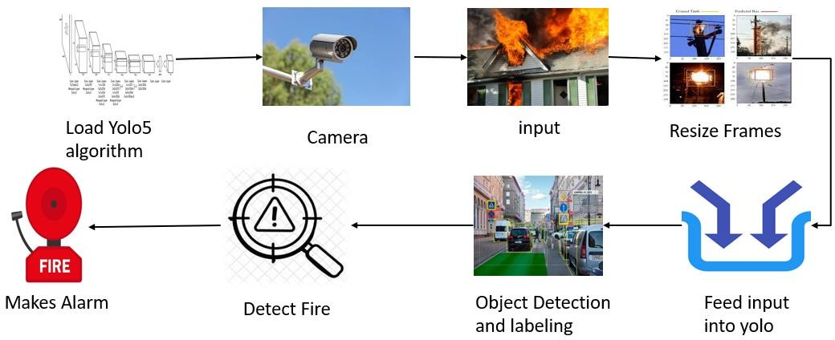
ARCHITECTURE

Slide 15
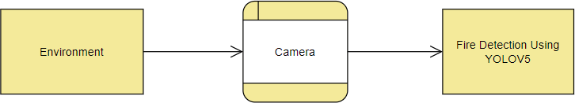
SYSTEM DESIGN – DFD LEVEL 0

Slide 16
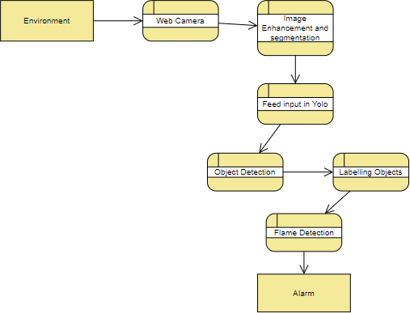
SYSTEM DESIGN – DFD LEVEL 1

Slide 17
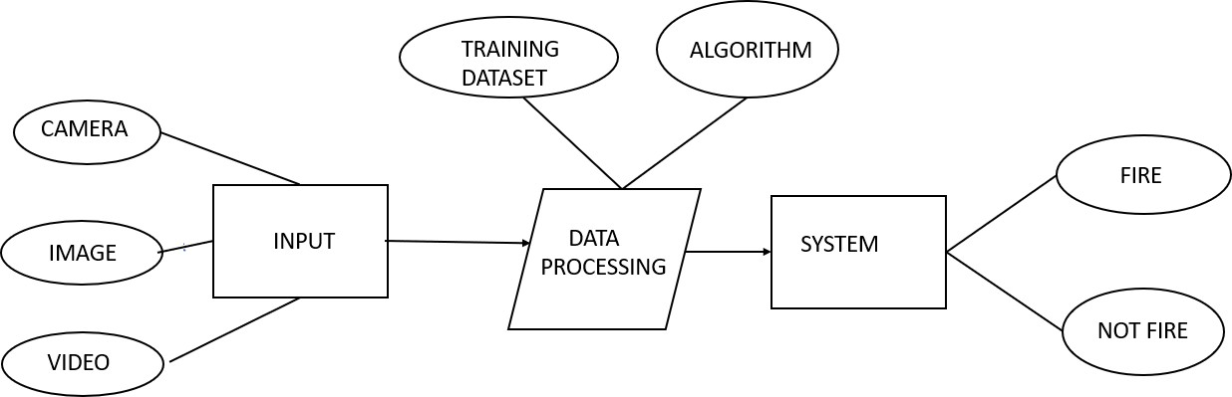
SYSTEM DESIGN - ER DIAGRAM

Slide 18
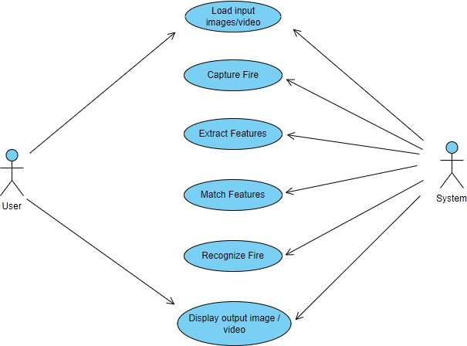
SYSTEM DESIGN – USE CASE DIAGRAM

Slide 19
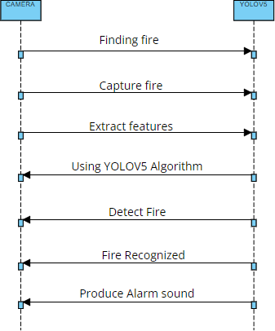
SYSTEM DESIGN – SEQUENCE DIAGRAM

Slide 20
MODULE DESCRIPTION
1. LOAD YOLO
1.1 Download Pre-trained Weights: The pre-trained weights for various YOLO versions are available on the official website. Download the weight files and store them in a folder
1.2 Load the configuration and weight files: In OpenCV, you can load the configuration and weight files using the cv2.dnn.readNetFromDarknet() function. This function takes two arguments: the path to the configuration file and the path to the weight file.

Slide 21
1.3 The YOLO algorithm is trained to recognize a specific set of objects. The class names can be loaded by reading a text file that contains one class name per line.
1.4 The input image needs to be preprocessed before feeding it to the YOLO network. Resizing the image to the same size as the input size of the network must be done.
1.5 Once the input image is preprocessed, set it as the input to the YOLO network using the net.setInput() function.

Slide 22
1.6 The forward pass of the network will generate a list of bounding boxes and class probabilities for the objects in the image.
1.7 Once you have the outputs from the network, you need to filter out the weak detections and non-maximum suppression to get the final set of bounding boxes and class probabilities.

Slide 23
2. START WEBCAM.
To start the webcam in OpenCV, you can use the cv2.VideoCapture() function. This creates a Video Capture object with a device index of 0, which represents the default webcam. It sets the width and height of the frame to 640 and 480, respectively, and starts a while loop to read frames from the webcam, display them, and exit the loop when the 'q' key is pressed.

Slide 24
3. IMAGE PROCESSING
Image processing is an essential component of YOLO, as it involves preparing and preprocessing the input images for object detection. The important steps in image processing involves:
Set Input and Output Layers: To set the input and output layers, use the "blobFromImage()" function to pre-process the input image for the network.
Resizing the input image to a fixed size: The YOLO model expects a fixed input size. Therefore, the input images are resized to a fixed size before being fed to the model.

Slide 25
Converting the image to a format suitable for the model: The YOLO model expects the input image to be in RGB color format. Therefore, if the input image is in a different format, it is converted to RGB.
Normalization: The pixel values in the input image are normalized to a range between 0 and 1. This step helps improve the accuracy and stability of the object detection model.

Slide 26
4.OBJECT DETECTION
Object detection is a fundamental task in computer vision that involves identifying the location and class of objects within an image or video. YOLOv5 is a state-of-the-art object detection algorithm that has gained significant popularity due to its speed and accuracy.
The YOLOv5 algorithm uses a deep neural network to predict bounding boxes, object classes, and confidence levels for each detected object in real-time. The algorithm works by dividing the input image into a grid of cells and predicting the probability of an object being present within each cell. Bounding boxes are then predicted for each cell that exceeds a certain threshold.

Slide 27
One of the main advantages of YOLOv5 is its speed. It can process up to 155 frames per second on a single GPU, which makes it suitable for real-time applications such as autonomous vehicles, surveillance cameras, and robotics. Additionally, YOLOv5 achieves state-of-the-art performance on many benchmark datasets, making it a reliable choice for object detection tasks.
To implement object detection using YOLOv5, one can use pre-trained models from the official repository or train a custom model on a specific dataset.

Slide 28
The implementation involves initializing the model architecture, loading the pre-trained weights or training the model on the dataset, and feeding the input image to the model to obtain predictions. The output predictions can then be visualized by drawing bounding boxes around the detected objects and labeling them with their corresponding class.
Overall, YOLOv5 has revolutionized object detection and inspired various applications across different industries. Its speed, accuracy, and ease of use make it a popular choice for developers and researchers alike.

Slide 29
5.POST PROCESSING
Post-processing is an essential step in computer vision (CV) that involves analysing and refining the output of a computer vision algorithm. Post-processing is particularly important in CV applications that involve object detection and recognition, as the output of these algorithms may contain errors or inaccuracies.
Some of the common techniques used in post-processing for CV include:
Non-maximum suppression: Non-maximum suppression is a technique used to eliminate duplicate detections of the same object. This involves identifying overlapping bounding boxes and selecting the one with the highest confidence score.

Slide 30
Bounding box refinement: Bounding box refinement is used to adjust the location and size of bounding boxes to better fit the detected object. This can improve the accuracy of object detection and recognition.
Post-classification analysis: Post-classification analysis involves analyzing the output of a classification algorithm to identify patterns or trends. This can help to improve the accuracy of object detection and recognition.

Slide 31
6. ALERTING
Alerting in OpenCV (Open Source Computer Vision Library) is a technique used to notify users of specific events or occurrences detected in a video stream or image. Alerting is a crucial component of many computer vision applications, such as security systems, where alerts need to be triggered if an intruder is detected.
Overall, alerting in OpenCV is an essential feature for many computer vision applications. The ability to trigger alerts based on specific events detected in a video stream or image is critical in applications such as surveillance, security, and monitoring systems.

Slide 32
TESTING
S.NO | TEST CASE | INPUT | STEPS | OUTPUT
1 | Fire detection accuracy | Different types of fires and non-fire images. | a. Create a dataset of images and videos containing different types of fires and non-fire objects b. Use the YOLOv5 algorithm to detect the presence of fire in the images and videos in the dataset c. Record the number of true positive, false positive, true negative, and false negative detections d. Calculate the precision, recall, and F1 score to evaluate the accuracy of fire detection using YOLOv5. | Correct prediction of images.

Slide 33
TESTING
S.NO | TEST CASE | INPUT | STEPS | OUTPUT
2 | YOLOv5 performance on different types of fires | Images resembling different types of fires. | a. Create a dataset of images and videos containing different types of fires such as campfires, wildfires, and house fires b. Use the YOLOv5 algorithm to detect the presence of fire in the images and videos in the dataset c. Compare the performance of YOLOv5 in detecting different types of fires by analyzing the accuracy and detection time. | Correct prediction of images even the location, size, and type of fire changes. The prediction is accurate

Slide 34
TESTING
S.NO | TEST CASE | INPUT | STEPS | OUTPUT
3 | Impact of environmental factors on YOLOv5's fire detection accuracy | Live video in different lighting conditions through web cam or images with different lighting conditions. | a. Test YOLOv5's fire detection performance under different lighting conditions such as daylight, low light, and darkness b. Observe how the algorithm performs in detecting fires under different weather conditions, such as haze or smoke. c. Measure how well YOLOv5 works in detecting fires at varying distances. | The system predicts the fire accurately.

Slide 35
TESTING
S.NO | TEST CASE | INPUT | STEPS | OUTPUT
4 | YOLOv5's ability to detect false positives | Images and videos containing objects that resemble fire. | a. Create a dataset of images and videos containing objects that resemble fire, such as bright lights, reflections, and sunsets. b. Run YOLOv5 algorithm to detect the presence of a fire in the images and videos in the dataset. c. Analyze the number of false positives generated by YOLOv5 by examining the images and videos in the dataset. | Detects only fire and not images that resemble fire.

Slide 36
TESTING
S.NO | TEST CASE | INPUT | STEPS | OUTPUT
5 | YOLOv5's ability to detect fires in crowded scenes | Fire images/video occurring in a crowded location. | a. Create a dataset of images containing crowds of people in which a fire occurs b. Run YOLOv5 algorithm to detect the presence of a fire in the images in the dataset. c. Measure how well the algorithm works in detecting fires when there is a crowd of people and other obstacles in the scene. | Detect fire even in a crowded place and produce alarm sound.

Slide 37
RESULTS
A crucial area of research entails creating algorithms and systems that can recognise fires as soon as they start. This is known as real-time fire detection. Real-time fire detection aims to minimise possible fire damage, such as property loss, human fatalities, and environmental harm.
The system was designed in such a way that successful fire detection could be accomplished because fire detection is crucial and must be done at the appropriate moment. The system sounds a warning as soon as a fire is discovered to alert people about the fire. A person nearby can be reached and the fire can be put out at the earliest stage.

Slide 38
Additionally, it can be used to keep an eye on commercial buildings and spot possible fire hazards early on, enabling early intervention and prevention.
In conclusion, real-time fire detection is a vital tool with the potential to prevent deaths and lessen the harm that fires do. Fire detection is successful with the growth of this system, making it a crucial component of fire prevention and control.

Slide 39
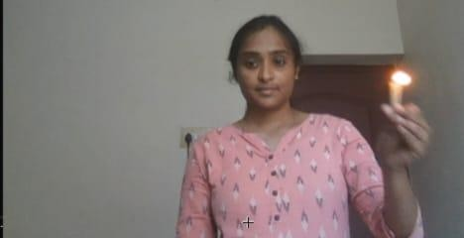
SCREEN SHOTS
INPUT

Slide 40
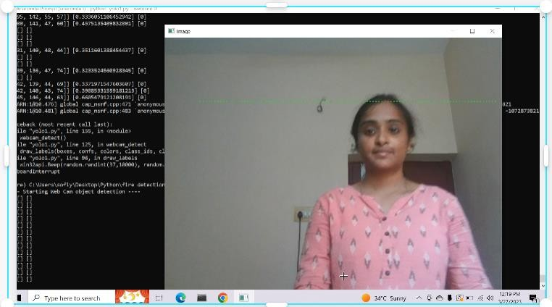
SCREEN SHOTS
OUTPUT

Slide 41
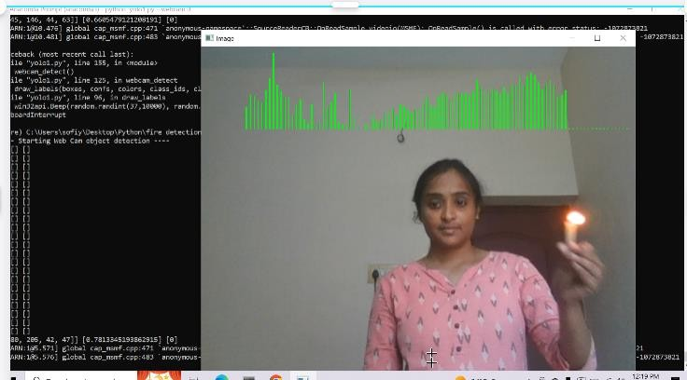
SCREEN SHOTS

Slide 42
CONCLUSION
The fundamental structure of YOLOV5 is real-time object detection algorithm. When properly used, YOLOV5 has many advantages in practice.
Being a unified object detection model that is simple to construct and train in correspondence with its simple loss-function, YOLOv5 can train the entire model in parallel.
YOLOV5 is also better at generalizing object representation compared with other object detection models and can be recommended for real-time object detection as the state-of-art algorithm in fire detection.

Slide 43
With these marks, it is acknowledgeable that the field of fire detection has an expanding, great future ahead.
The experiments showed that changed the algorithm (model size) and the dataset could quickly detect a real- time fire with a high degree of accuracy.

Slide 44
FUTURE ENHANCEMENT
Future work will include improving the accuracy of our method and handling blurring issues in nighttime environments.
Our future projection is to build a lightweight model with robust detection performance that would allow us to set up embedded devices with low computational capabilities.
Future work will be based on using geostationary satellite imagery for rapid monitoring of active fires to provides high temporal resolution for fast monitoring in a larger scale.

Slide 45
REFERENCE PAPER
[1] Veerappampalayam Easwaramoorthy Sathishkumar, Jaehyuk Cho, Malliga Subramanian, and Obuli Sai Naren, “Forest fre and smoke detection using deep learning-based learning without forgetting”, 2023.
[2] Seyd Teymoor Seydi, Vahideh Saeidi, Bahareh Kalantar, Naonori Ueda and Alfian Abdul Halin, "Fire-Net: A Deep Learning Framework for Active Forest Fire Detection", Feb 2022
[3] Shuai Zhao, Boyun Liu, Zheng Chi, Taiwei Li and Shengnan Li, "Characteristics Based Fire Detection System,Under the Effect of Electric Fields With Improved Yolo-v4 and ViBe", August 2022.

Slide 46
REFERENCE PAPER
[4] Byoungjun Kim and Joonwhoan Lee, “A Video-Based Fire Detection Using Deep Learning Models”, July 2019.
[5] Herminarto Nugroho, "Fully Convolutional Variational Autoencoder For Feature Extraction Of Fire Detection System", March 2020.

Slide 47
REFERENCE PAPER
[6] Xiwen Chen, Bryce Hopkins, Hao Wang, Leo O' Neill, Fatemeh Afghah, et al, "Wildland Fire Detection and Monitoring Using a Drone-Collected RGB/IR Image Dataset", Nov 2022.
[7] Xuehui Wu1, Xiaobo Lu1, and Henry Leung, “An Adaptive Threshold Deep Learning Method for Fire and Smoke Detection,” Oct 2017
[8] Taha Zaman, Muhammad Hasan, Saneeha Ahmed, Shumaila Ashfaq, "Fire Detection Using Computer Vision" , 2019

Slide 48
REFERENCE PAPER
[9] Murat Muhammet Savcı, Yasin Yıldırım, Gorkem Saygili, and Behcet Ugur Toreyin, “Fire Detection in H.264 Compressed Video” 2019.
[10] Xuehui Wu, Xiaobo Lu, Henry Leung, "An Adaptive Threshold Deep Learning Method for Fire and Smoke Detection", Oct 2017.
[11] Zhenyang Xue, Haifeng Lin, and Fang Wang, “A Small target forest fire detection model based on yolov v5 improvement” Aug 2022.

Slide 49
BASE PAPER
“SPATIO – TEMPORAL SELF ATTENTION NETWORK FOR FIRE DETECTION AND SEGMENTATION IN VIDEO SURVEILLANCE”– Mohammad Shahid, John Jethro Virtusio, Yu-Hsien Wu, Yung-Yao chen, M Tanveer, Khan Muhammad, and kai-Lung Hua.
https://drive.google.com/file/d/113HhKRXt6Ocb3udHnRgT-sahSNKJ2eH8/view?usp=drivesdk

